Slide 1
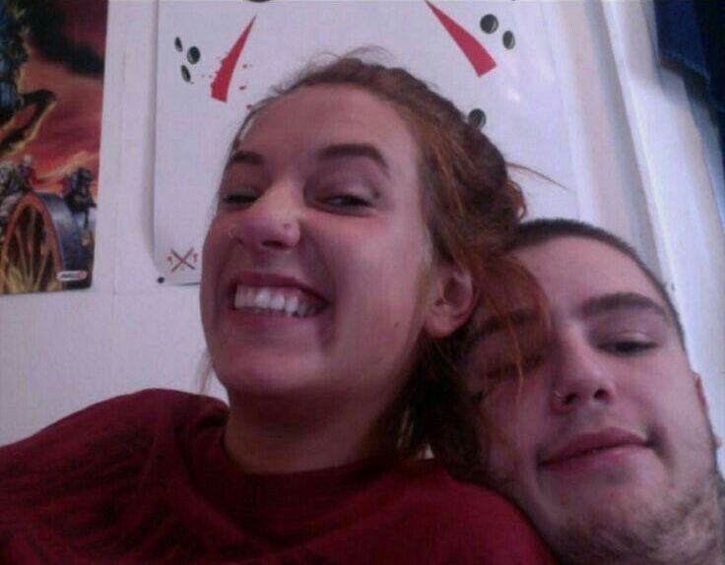

Teen Romance
LIL PEEP

Slide 2

I met her by chance

Slide 3
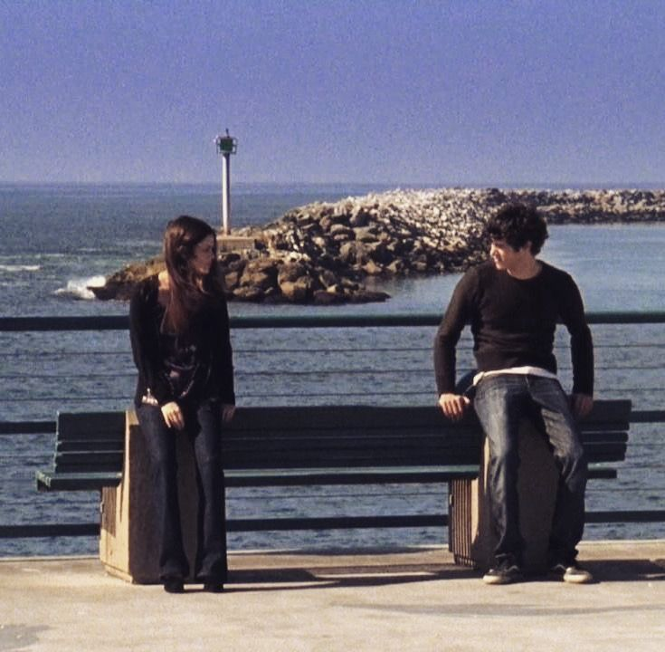
I said, "I really like your pants"

Slide 4
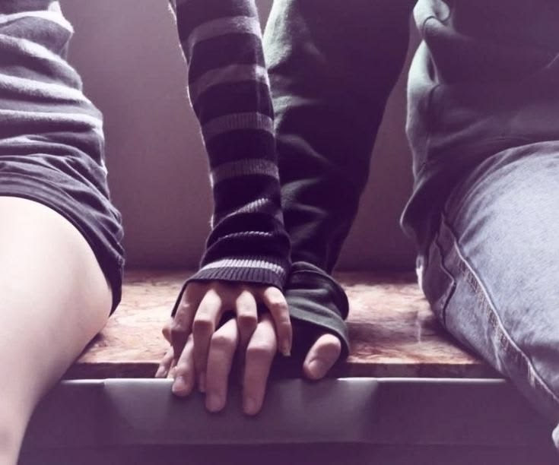
I know you got a man Gimme your hand (fuck it)

Slide 5
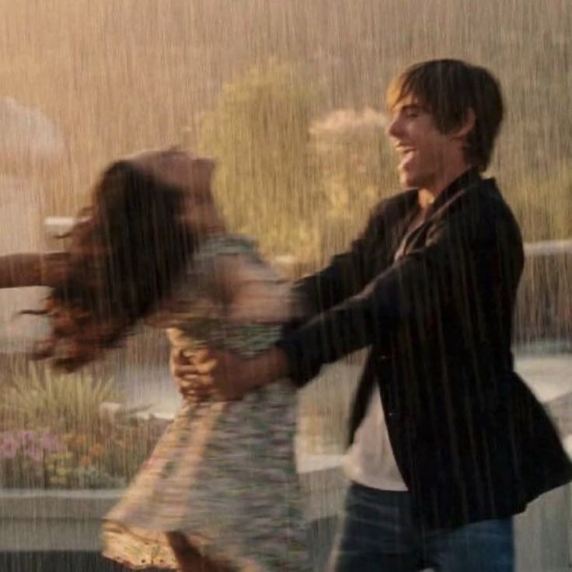
Teen romance, gimme this dance

Slide 6
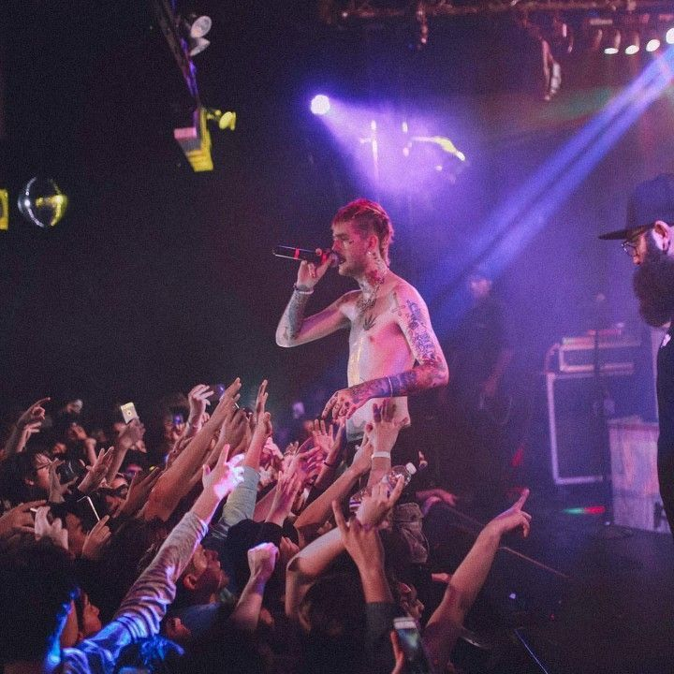
Yeah, I took a Xan (yeah) I hope you understand (she don't)

Slide 7
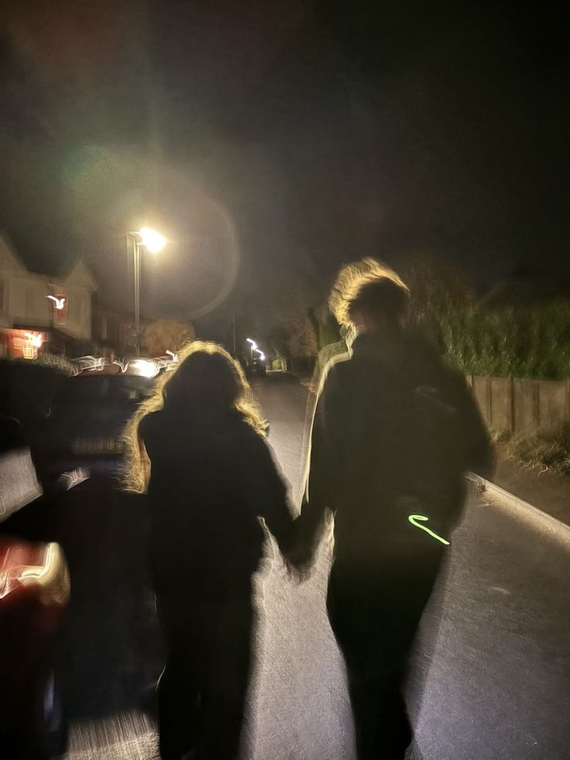
Let me guide you to a place where no one hurts you

Slide 8
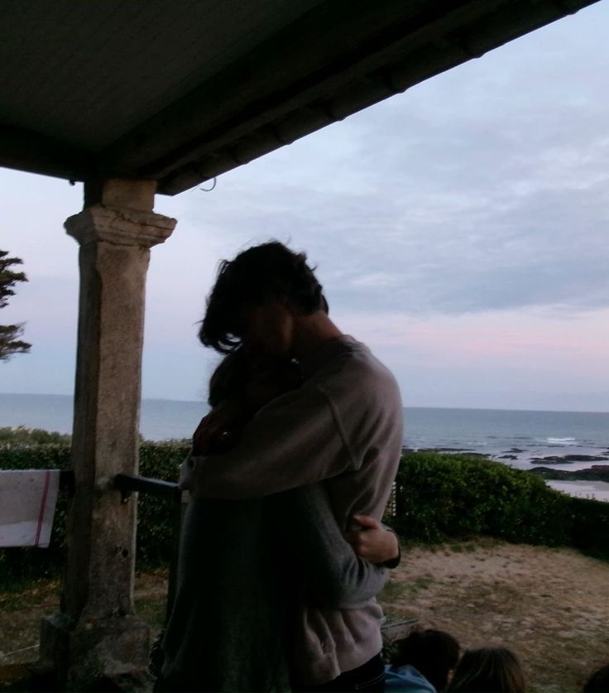
You are safe here with me (with me, with me)

Slide 9
